Slide 1
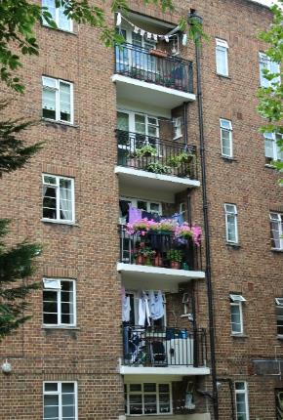
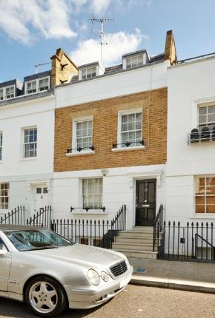
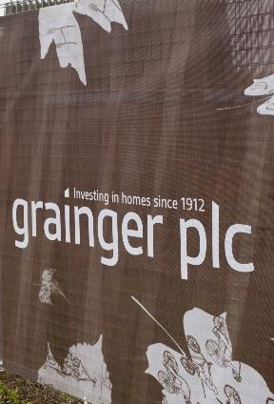

Connect Programme
Programme & architecture review
Open Box
8 Feb 2021

Slide 2


























Elements of the Connect Platform
Connect will be the leading and most comprehensive technology platform in the property sector. Its scope includes best-in-class solutions in 12 different areas:
Solution | Supplier | Comments
Core ERP and Financial Operations |  | MRI is a comprehensive and flexible platform able to support every aspect of real estate management. Grainger is a pioneer adopting MRI in the UK
Property and Supplier Management |  | FSI Concept Evolution connects our customers and our suppliers for repairs. It replaces and improves on the CORAS HSE solution.
Purchase to Pay |  | ProActis is a step change in how Grainger processes supplier invoices, providing strong controls and minimal human intervention
Customer Relationship / Online Leasing Journey |  | Salesforce is the world’s leading customer relationship management solution. It provides a single view of our customers and prospects
Customer Portal |  | AND Digital is building the digital interfaces through which the customer interacts with Grainger: the leasing portal and the MyGrainger portal
Payments |  | Asperato is a leading customer payments solution for Direct Debit and Card. It is integrated with Salesforce and PCI compliant.
Document Management |  | We are upgrading our Document Management solution to better capture and tag documents across the entire Connect platform.
Revenue Optimisation |  | Grainger is a pioneer in the UK market adopting YieldStar to optimise rent occupancy rates and pricing, based on real time data.
Financial Planning & Analysis |  | As a unified Platform for Corporate Performance Management, OneStream will generate consolidated reports automatically integrated with Connect
Business Intelligence & Analytics |  | Our new Data Warehouse follows a industry best practice and will set the basis to drive customer insight in the long term
Transactional Communications |  | Our transactional communications will be managed by best-in-class tools in a way that is consistent to the customer and efficient for Grainger.
System Integration |  | Our integration layer future-proofs the Connect platform, by allowing the upgrade, removal or addition of technology components
Original core system
Grainger Plc | www.graingerplc.co.uk | Board Update | February 2019

Slide 3
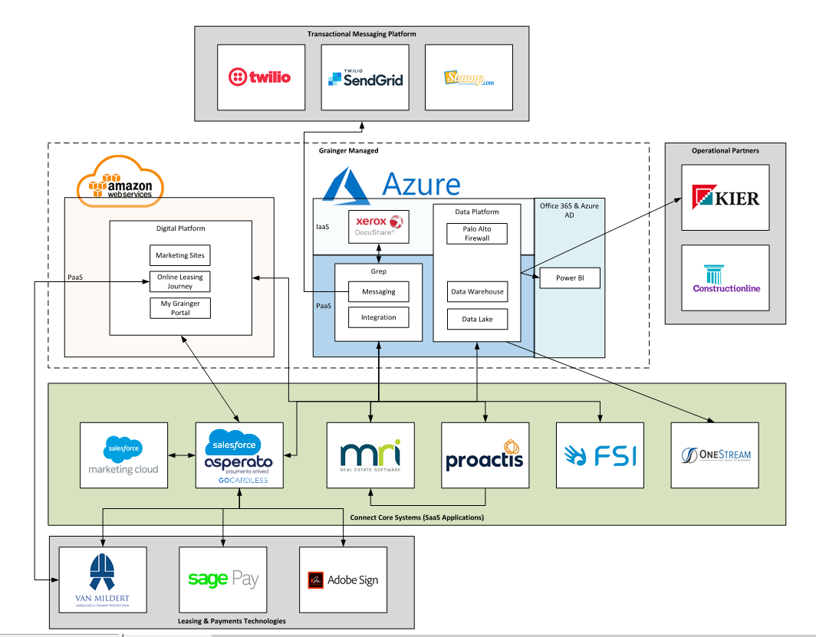
High-level Platform architecture

Slide 4
Regulated Tenancies carry most of non-standard residential billing
The guiding principle for splitting units across the 2 MRI modules (RM and CM) is based on the functionality in each one of the modules. CM is able to handle service charges, therefore it holds the commercial leases and also all tenures that involve service charges (leaseholds, ground rents, shared ownership). All the ‘short’ residential leases (mainly AST’s and regulated) would be held in RM.
The population impacted by the MRI deficiency are 1,292 regulated (and some affordable) tenants who are charged weekly. This is not a core customer segment for Grainger and is expected to shrink in the future. However the billing activity and arrears management are intense in this segment – so they should be the focus for a decision to be made in this topic.
 | Residential Module (RM) |  |  | Commercial Module (CM) |  | Total
Tenure | Short tenancies (BTR, AST, Comp-Let, Affordable) | Garages / Sheds | Regulated, Assured, Weekly Affordable | Commercial, Leasehold, Ground Rents | Shared Ownership
Billing Freq
Monthly | 3,590 | 587 | 1,141 | 651 | 199 | 6,168
Quarterly, Half Yearly, Yearly | 77 | 335 | 130 | 14,447 | 398 | 15,387
Weekly | 64 | 5 | 1,292 | 118 | 2 | 1,481
Fortnightly, legal Quarters, Others | 0 | 75 | 3 | 1,471 | 0 | 1,540
Total | 3,731 | 1,002 | 2,566 | 16,688 | 599 | 24,586
 | 15% | 4% | 10% | 68% | 2% | 100%

Slide 5
MRI solution evolution: 2018 to date
MRI was the original core ERP solution, however given the adoption of best of breed applications namely FSI, Proactis and Salesforce, this is no longer the case. MRI hosts the master data of the platform and supports supplier management, but beyond that most of the MRI capability resides in finance or has been specifically built.
Connect – Core Capabilities |  | Core System per capability
Connect – Core Capabilities | Connect – Core Capabilities | H1 2018 | H2 2018 | H1 2019 | H2 2019 | H1 2020 | H2 2020
PG1: Property & Suppliers | Compliments & Complaints | MRI | FSI | FSI | FSI | FSI | FSI
 | Facilities Management | MRI (RAM) | FSI | FSI | FSI | FSI | FSI
 | Supplier Management | MRI | MRI | MRI | MRI | MRI | MRI
 | Purchase to Pay | MRI (Nexus) | Proactis | Proactis | Proactis | Proactis | Proactis
PG2: Charges & Payments | Accounting: charges & payments | MRI | MRI | MRI | MRI | MRI | MRI
 | Arrears | MRI | MRI (custom) | MRI (Custom) | MRI (Custom) | MRI (Custom) | MRI (Custom)
 | Amenities | MRI | MRI | FSI | FSI | FSI | FSI
 | Collecting Payments | SP/ ME | SP/ME | SP/ME | Salesforce | Salesforce | Salesforce
PG3: Leasing, Move-in / Move-Out | Lead Management | PEX | PEX | PEX | Salesforce | Salesforce | Salesforce
 | Leasing | PEX | PEX | PEX | Salesforce | Salesforce | Salesforce
 | L2L Payments | SP/ME | SP/ME | PEX | Salesforce | Salesforce | Salesforce
 | Move in / Move out | MRI | MRI | FSI | FSI | FSI | FSI
 | Revenue Management | YieldStar | YieldStar | YieldStar | YieldStar | tbd | tbd
 | Renewals | MRI | MRI | MRI | Salesforce | Salesforce | Salesforce
PG4: Onboarding & Sales | Onboarding | MRI | MRI (template) | MRI (template) | MRI (template) | MRI (template) | MRI (template)
 | Job Costing | (Not available) | (Not available) | (Not Available) | MRI | MRI | MRI
 | Property Sales / Valuation | (Not available) | MRI (Custom) | MRI (Custom) | MRI (Custom) | MRI (Custom) | MRI (Custom)
 | Property Sales accounting | MRI | MRI | MRI | MRI | MRI | MRI
PG5: Finance | Service Charge | MRI | MRI | MRI | MRI | MRI | MRI
 | Accounting | MRI | MRI | MRI | MRI | MRI | MRI
 | Cash Management | MRI | MRI | MRI | MRI | MRI | MRI
 | Insurance | MRI | MRI | MRI | MRI | MRI | MRI
 | Staff Expenses | MRI | Proactis | Proactis | Proactis | Proactis | Proactis
 | FP&A | (Not available) | (Not available) | (Not available) | OneStream | OneStream | OneStream
 | Rent Review | MRI | MRI (Custom) | MRI (Custom) | MRI (Custom) | MRI (Custom) | MRI (Custom)
 | Tax | MRI | MRI | MRI | MRI | MRI | MRI
Shared & Enabling functionality | Master Data | MRI | MRI | MRI | MRI | MRI | MRI
 | Single View of Customer | MRI | MRI | MRI | Salesforce | Salesforce | Salesforce
 | Reporting (finance) | Board | Board | Board | OneStream | OneStream | OneStream
 | Reporting (general) | MRI | MRI | MRI | Power BI | Power BI | Power BI
 | Document Storage | Docushare | Docushare | Docushare | DMS | DMS | DMS
Key / MRI capabilities
Finance capability – Core MRI
Non-finance capability – Core MRI
Finance capability – Customised
Non-finance capability – Customised

Slide 6

Capability gaps post Phase 1 go-live
In this review we are asking MRI to look beyond fixing defects for go-live, and evaluate the overall solution in the context of Connect. We have made compromises in scope and design through the history of Connect, and our ‘phase 1’ Connect solution going live with MRI will not meet the expectations of the Grainger users. We must be sure that the solution will be acceptable in the medium and long terms from the points of view of functionality, usability and user experience.
Connect Phase 1 gaps: effort required to address workarounds post go-live | Connect ‘Phase 1’ capability: Readiness to go live (vs outstanding defects) |  | initial / day 1 capability
 |  |  | Capability gap? (R, A, G) | Caused by/ related to MRI?
PG1: Property & Suppliers | Compliments & Complaints
 | Facilities Management
 | Supplier Management
 | Purchase to Pay |  |  | Direct (MRI Performance)
PG2: Charges & Payments | Accounting: charges & payments |  |  | Indirect (MRI Complexity)
 | Arrears
 | Amenities |  | Amenities booking via portal
 | Charges & Payments
PG3: Leasing, Move-in / Move-Out | Lead Management
 | Leasing & Renewals |  | ’Option 4’ integrations | Indirect (Integration support)
 | L2L Payments & Accounting
 | Move in / Move out |  | Move-in / Move-out integrations | Indirect (MRI Complexity)
 | Revenue Management
PG4: Onboarding & Sales | Onboarding |  |  | Direct (MRI Complexity)
 | Job Costing
 | Property Sales / Valuation
 | Property Sales accounting
PG5: Finance | Service Charge |  | MRI Service Charge functionality | Direct (MRI Complexity)
 | Accounting |  | Post GL journals / prepaid revenue | Direct (MRI Functionality)
 | Cash Management |  | Bank recs / Bank mapping tables | Direct (MRI Functionality)
 | Insurance |  | MRI Improvements | Direct (MRI Functionality)
 | Staff Expenses
 | FP&A
 | Rent Review
 | Tax |  |  | Direct (MRI Functionality)
Shared & Enabling functionality | Master Data |  | Maintenance of tables | Direct (MRI Complexity)
 | Customer portals |  | MyGrainger customer Portal
 | Single View of Customer
 | Reporting (finance)
 | Reporting
 | Audit & Compliance |  | MRI Audit module | Direct (MRI Functionality)
 | Document Storage
Most of the major functionality gaps post ‘phase 1’ relate to MRI, with few exceptions like the Customer Portal, ‘Option 4’ integrations at the end of the Leasing Journey, and the move-in / move-out integrations.
During UAT the finance team raised a number of usability issues that add to the list of manual workarounds. They include intercompany transactions, posting & approving GL journals. We have provided the full list to MRI
Updates slide #9 in the February Board Pack

Slide 7
Objective – L&P | Date
We have the Catalogue of data definitions relevant to L&P (AB)
Identified and agreed with business the people in critical roles of process owners, data owners etc for all relevant data in the catalogue of definitions
We have agreed a set of DQ KPIs with the business
We have prepared all the training materials necessary to provide the training | 19/Feb
We have updated our Data Quality (DQ) Dashboard so it can capture Salesforce data issues (and alert process owners / data champions of issues) | 8/Mar
We have engaged and trained all of the required people on their respective roles | 8/Mar

